Slide 1
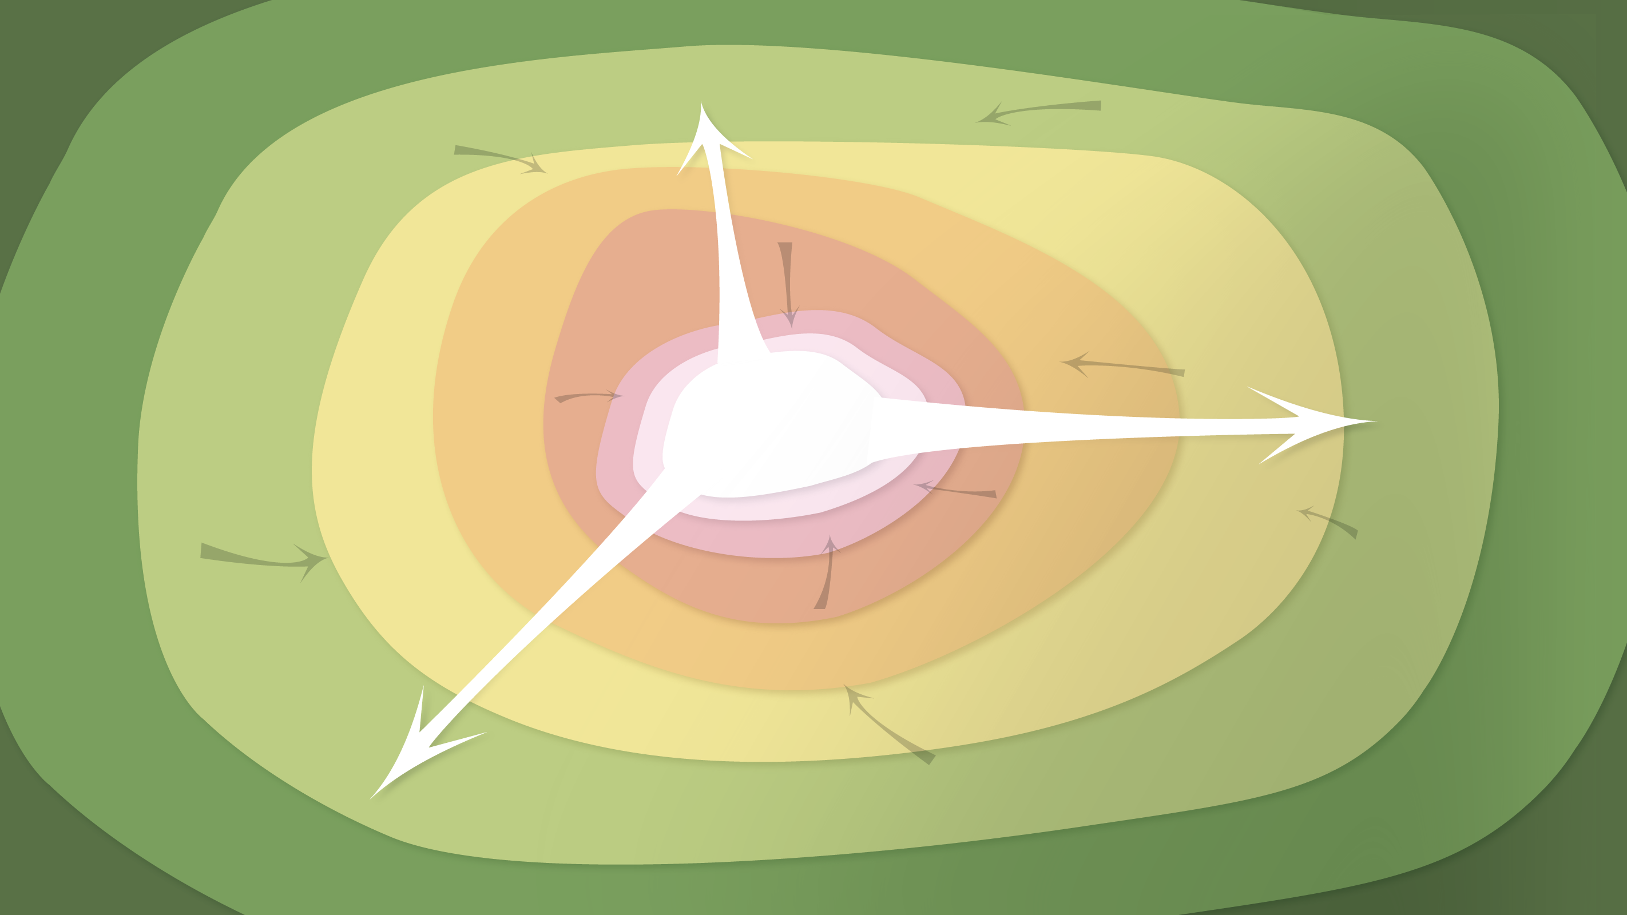
Data Management in the Research Environment
RSM 574/674 Spring 2016
Dr. Timothy Norris – Postdoctoral Fellow Richter Library – tnorris@miami.edu
Angela Clark – Librarian Associate Professor RSMAS – aclark@rsmas.miami.edu

Slide 2
Course Overview
Why manage data / what is data management
Data lifecycle and data management plans
Data types, stages and formats
Data organization / tips, tools and techniques
Research data profiles
Contextual metadata
Software carpentry: git bash command line, tools, and basic scripting
Intellectual property and licensing
Sharing data, data repositories and data preservation

Slide 3
Class Schedule
Week 1: Course Introduction and Overview: What is data and why are we here?
Week 2: The Research Data Lifecycle
Week 3: Data Types, Stages, and Formats [ TURN IN ASSIGNMENT #1 ]
Week 4: Data Organization (software carpentry: BASH shell) [ ASSIGNMENT #2 COMPLETE ]
Week 5: Data Storage, Backup and Security
Week 6: Data Curation Profiles
Week 7: Open Lab
Week 8: Metadata and Contextual Details [ TURN IN MIDTERM PROJECT ]
Weeks 9 and 10: (software carpentry) [ TURN IN ASSIGNMENT #3 ]
Week 11: Finding and Cleaning Data [ ASSIGNMENT #4 COMPLETE ]
Week 12: Sharing and Reuse: Intellectual Property and Licensing
Week 13: Repository Identification / Preparation for Preservation / Unique Identifiers
Week 14: Open Lab [ TURN IN ASSIGNMENT #5 ]
Finals Week: [ TURN IN FINAL PROJECT ]

Slide 4
what you expect / what we expect syllabus review
Two credit course – moderate load – reading most weeks with a few breaks
Two major assignments
Midterm assignment: written document based on ongoing research either in your advisors lab or in a colleagues lab. DUE WEEK 8 (30% OF GRADE)
Final Assignment: Either a written data management plan for your research (or your lab’s research) or a dataset prepared for repository deposit. DUE FINALS WEEK (40% OF GRADE)
NOTE: there is no final exam
Several minor assignments
there are five minor assignments that will help you prepare the major assignments
(20% OF GRADE)

Slide 5
Software Carpentry http://software-carpentry.org/
There will be no class for weeks 9 and 10 (this may change!), instead you will be required to attend a two day software carpentry workshop
Your choice: R or Python
Most likely between March 14th and March 25th (TBD)
Good to learn the value of command line computing
Great to learn how to teach and navigate command line computing

Slide 6
your participation . . .
This class IS:
about interdisciplinary problem solving
personal and professional practice
broad thinking
. . . is important
This class is NOT:
computer science
database administration
research methods (how to collect data)
10% OF GRADE

Slide 7
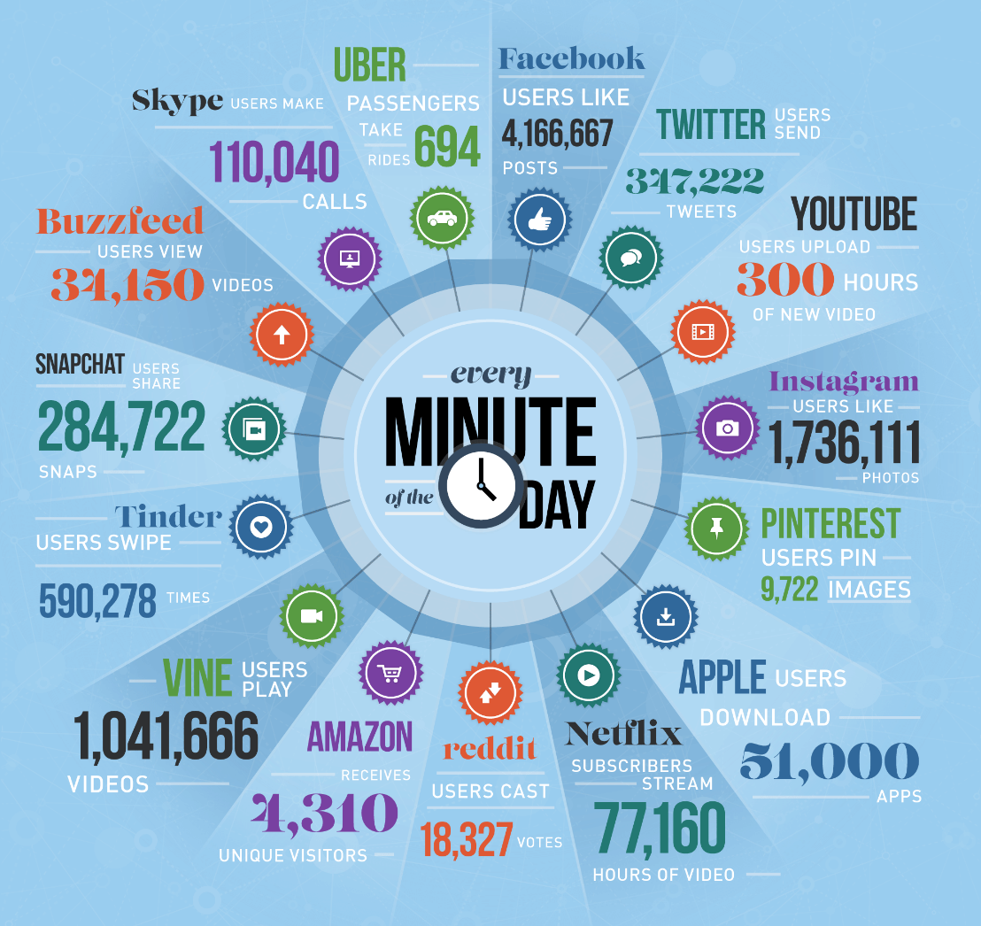
Big Data
https://www.domo.com/blog/2015/08/data-never-sleeps-3-0/

Slide 8
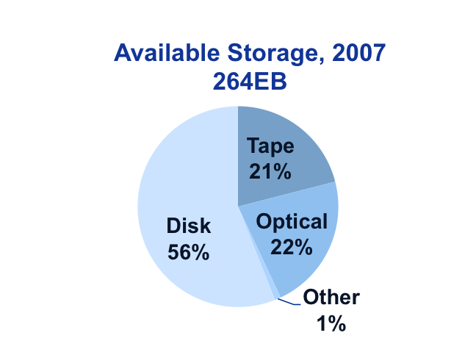
The World of Data Around Us)
Transient information or unfilled demand for storage
Information
Petabytes Worldwide
Available Storage
Source: John Gantz, IDC Corporation: The Expanding Digital Universe
Notes:
8
The amount of available storage is not keeping up with the amount of data flooding in daily. How do we decide what data we keep?

Slide 9
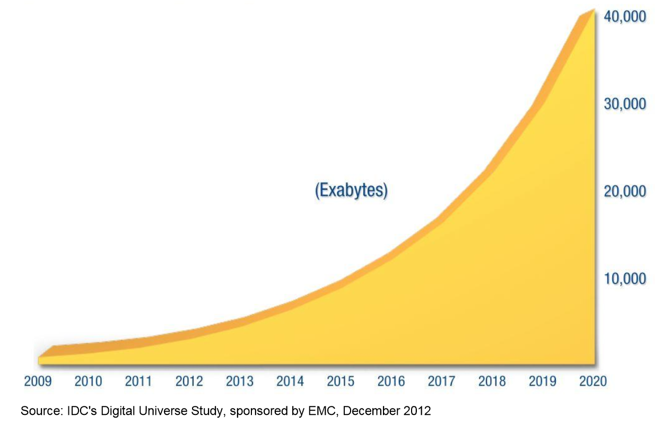
data growth
Gantz, J., & Reinsel, D. (2012). The Digital Universe in 2020: Big Data, Bigger Digital Shadows, and Biggest Growth in the Far East. Retrieved from https://www.emc.com/collateral/analyst-reports/idc-the-digital-universe-in-2020.pdf. Page 3.

Slide 10
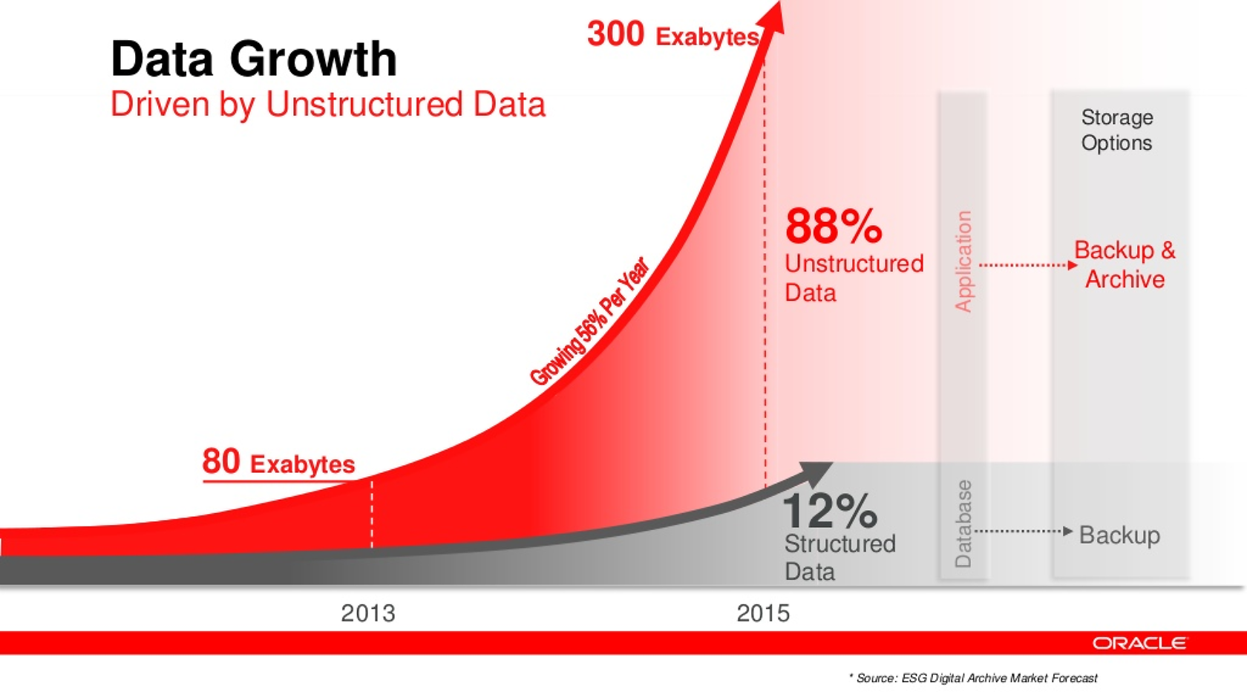
Navarro, Fran (2014). Foco en Almacenamiento. Accessed from http://www.slideshare.net/franmod/tendencias-storage. Slide 42.

Slide 11
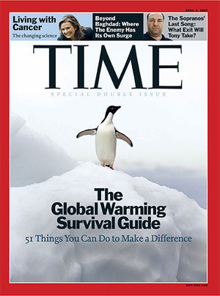

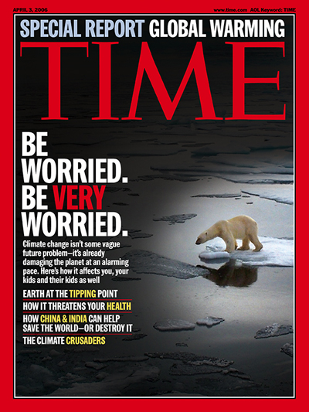
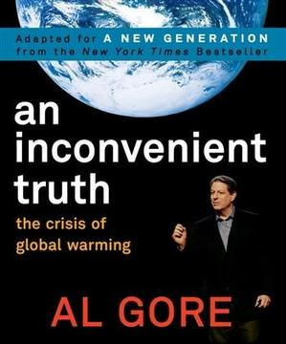
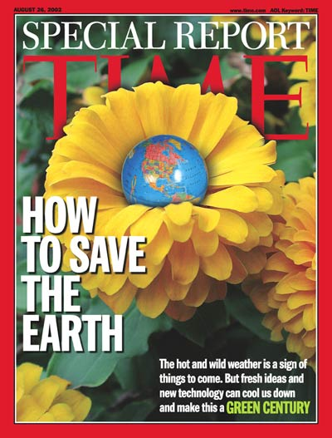

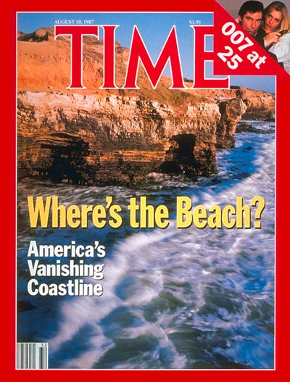
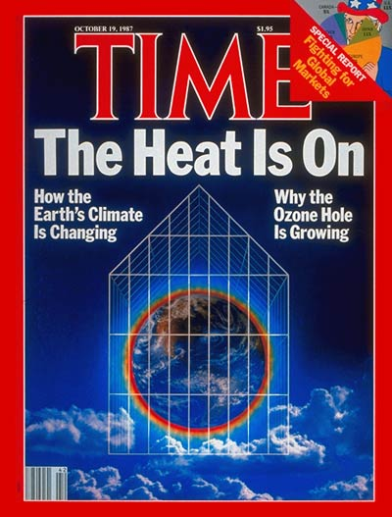
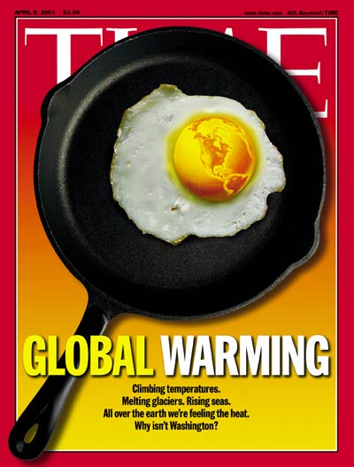
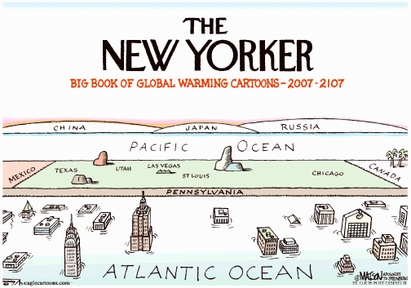
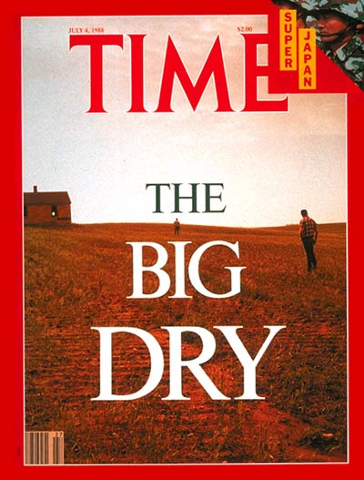
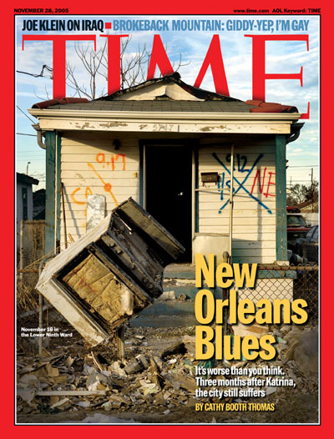

Images collected by DataOne.org
Notes:
The world today is filled with science news, from climate change to hurricanes – and it all affects the people inhabiting the earth.

Slide 12
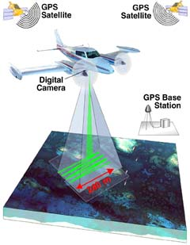
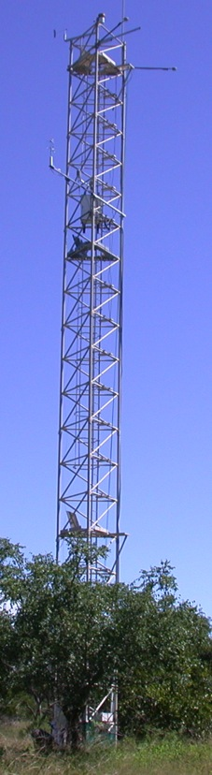

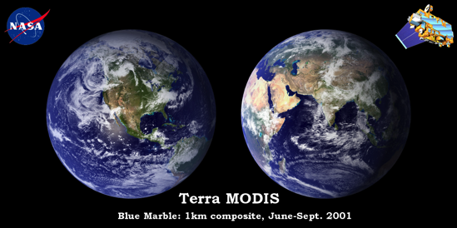
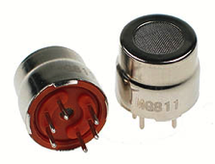
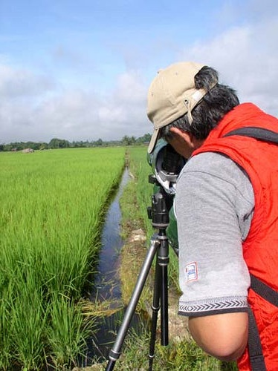
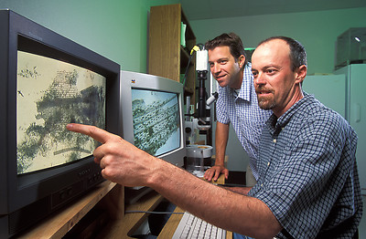
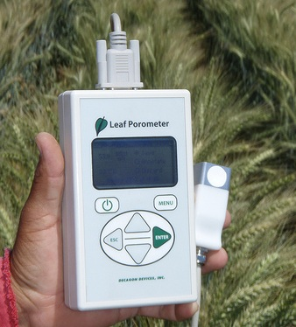
Data deluge
Data is collected from sensors, sensor networks, remote sensing, observations, and more - this calls for increased attention to data management and stewardship
Photo courtesy of http://modis.gsfc.nasa.gov/
Photo courtesy of
http://www.futurlec.com
CC image by tajai on Flickr
Photo courtesy of www.carboafrica.net
CC image by CIMMYT on Flickr
Image collected by Viv Hutchinson
Notes:
Data is being generated in massive quantities daily. Improvements in technology enable higher precision and coverage in data acquisition and makes higher capacity systems store and migrate more data –increasing the importance of managing, integrating, and re-using data.

Slide 13

The Data Deluge
Data Sharing Requirements
NIH: October 2003
Data Management Requirements
NSF: Jan 2011
NEH: June 2011
The 2013 OSTP Memo: Open Data
Federally funded research results should be made accessible to the public
Both peer-reviewed publications and data
Notes:
The Matrix - 1999
Big Data . . .
Talk to the data deluge, what are the responses in academia? In the public sector? Perhaps this is why we are here today?
NIH early data sharing requirements from grants over $500,000 – stringent controls for privacy and proprietary data
The 2011 NSF requirement to have data management plans in the grant proposals – there are program specific requirements
Most are simply two page documents with requirements to outline:
Data types to be collected
Standards to be used for metadata and data
Sharing policies (access, privacy, IP, etc.)
Re-use policies (distribution, derivatives
Plans for archival
Note that these requirements caused quite the scramble. No grant money if you could not include a plan.
Note that many foundations now also have data management requirements
Even private sector contracts require data management planning

Slide 14
What is DATA Management?
¿Data?
“Examples of Research Data and Materials include laboratory notebooks, notes of any type, photographs, films, digital images, original biological and environmental samples, protocols, numbers, graphs, charts, numerical raw experimental results, instrumental outputs from which Research Data can be derived and other deliverables under sponsored agreements.”
Johns Hopkins University (2008)
http://jhuresearch.jhu.edu/Data_Management_Policy.pdf
Numbers
Words
Citations / references
Notebooks / marginalia
Specimens
Field Samples
Images
Videos / sound recording
Relationships
Models
Code
Notes:
The Matrix - 1999
Big Data . . .
Talk to the data deluge, what are the responses in academia? In the public sector? Perhaps this is why we are here today?
NIH early data sharing requirements from grants over $500,000 – stringent controls for privacy and proprietary data
The 2011 NSF requirement to have data management plans in the grant proposals – there are program specific requirements
Most are simply two page documents with requirements to outline:
Data types to be collected
Standards to be used for metadata and data
Sharing policies (access, privacy, IP, etc.)
Re-use policies (distribution, derivatives
Plans for archival
Note that these requirements caused quite the scramble. No grant money if you could not include a plan.
Note that many foundations now also have data management requirements
Even private sector contracts require data management planning

Slide 15
What is DATA Management?
¿Data?
Definitions: The term “Research Data” in this document refers to information recorded and/or collected for research performed at or under the auspices of the University regardless of the form or the media upon which it is recorded. This term includes, but is not limited to, computer programs (code and documentation), computer databases, instrumental outputs, raw numerical results, original biological or environmental samples, photographs, digital images, films, protocols, graphs, and other deliverables produced under sponsored agreements. Research Data also includes any records related to the design, conduct or reporting of the research that would be necessary to reconstruct the reported research results. Research data can be intangible (statistics, findings, conclusions, etc.) and tangible (notebooks, printouts, etc.).
Notes:
The Matrix - 1999
Big Data . . .
Talk to the data deluge, what are the responses in academia? In the public sector? Perhaps this is why we are here today?
NIH early data sharing requirements from grants over $500,000 – stringent controls for privacy and proprietary data
The 2011 NSF requirement to have data management plans in the grant proposals – there are program specific requirements
Most are simply two page documents with requirements to outline:
Data types to be collected
Standards to be used for metadata and data
Sharing policies (access, privacy, IP, etc.)
Re-use policies (distribution, derivatives
Plans for archival
Note that these requirements caused quite the scramble. No grant money if you could not include a plan.
Note that many foundations now also have data management requirements
Even private sector contracts require data management planning

Slide 16
What is research data?
“Unlike other types of information, research data are collected, observed, or created, for the purposes of analysis to produce and validate original research results.”
University of Edinburgh
MANTRA Research Data Management Training,
‘Research Data Explained’
Whitmire, Amanda L. (2014). Research Data Management Curriculum, Lecture 1: Introduction to Research Data Management. Oregon State University Libraries. Retrieved 11/04/2015 from: http://figshare.com/articles/GRAD521_Research_Data_Management_Lectures/1003835
Notes:
…”Data may be viewed as the lowest level of abstraction from which information and knowledge are derived.”

Slide 17
Research data is:
“…the recorded factual material commonly accepted in the scientific community as necessary to validate research findings.”
U.S. Office of Management and Budget, Circular A-110
Whitmire, Amanda L. (2014). Research Data Management Curriculum, Lecture 1: Introduction to Research Data Management. Oregon State University Libraries. Retrieved 11/04/2015 from: http://figshare.com/articles/GRAD521_Research_Data_Management_Lectures/1003835
Notes:
Does not include, “any of the following: preliminary analyses, drafts of scientific papers, plans for future research, peer reviews, or communications with colleagues. This "recorded" material excludes physical objects (e.g., laboratory samples).” This narrow definition mostly takes a retrospective view of your dataset, in that it does not account for raw and intermediate data that may be critical to the research process but that don’t become part of the ’final’ dataset.
Data types could be:
Observational
Experimental
Simulated
Derived
Reference or canonical

Slide 18

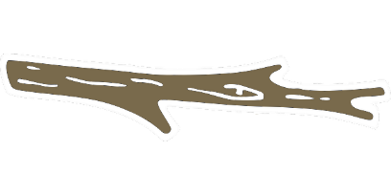
Why Manage Data
Productivity
Publishing
Knowledge creation
Career advancement
¿ SOMETHING ELSE?
+
Compliance
Grant writing
University policy
Research ethics
http://www.pd4pic.com/images800_/carrot-orange-vegetable.png
http://www.pd4pic.com/images/stick-outline-tree-branch-wood.png

Slide 19
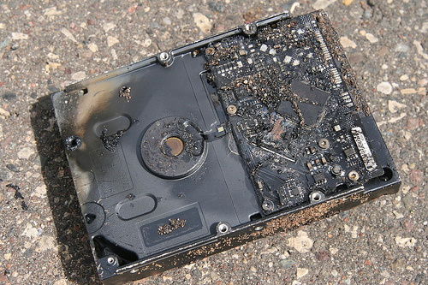
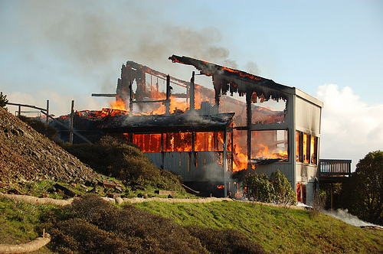
The World of Data Around Us: Data Loss
Natural disaster
Facilities infrastructure failure
Storage failure
Server hardware/software failure
Application software failure
External dependencies (e.g. PKI failure)
Format obsolescence
Legal encumbrance
Human error
Malicious attack by human or automated agents
Loss of staffing competencies
Loss of institutional commitment
Loss of financial stability
Changes in user expectations and requirements
CC image by Sharyn Morrow on Flickr
CC image by momboleum on Flickr

Slide 20
Poor Data Management Affects Everyone
“MEDICARE PAYMENT ERRORS NEAR $20B” (CNN) December 2004
Miscoding and Billing Errors from Doctors and Hospitals totaled $20,000,000,000 in FY
2003 (9.3% error rate) . The error rate measured claims that were paid despite being
medically unnecessary, inadequately documented or improperly coded. In some
instances, Medicare asked health care providers for medical records to back up their
claims and got no response. The survey did not document instances of alleged fraud.
This error rate actually was an improvement over the previous fiscal year (9.8% error rate).
“AUDIT: JUSTICE STATS ON ANTI-TERROR CASES FLAWED” (AP) February 2007
The Justice Department Inspector General found only two sets of data out of 26
concerning terrorism attacks were accurate. The Justice Department uses these
statistics to argue for their budget. The Inspector General said the data “appear to be
the result of decentralized and haphazard methods of collections … and do not appear
to be intentional.”
“OOPS! TECH ERROR WIPES OUT Alaska Info” (AP) March 2007
A technician managed to delete the data and backup for the $38 billion Alaska oil
revenue fund – money received by residents of the State. Correcting the errors cost the
State an additional $220,700 (which of course was taken off the receipts to Alaska
residents.)
Slide courtesy of BLM
Notes:
Data Costs
Consider some of the data management issues that made headlines, affecting agencies and organizations. Data quality is not limited to any one organization. These examples show costs (in terms of money lost) due to a lack of data quality control.
“MEDICARE PAYMENT ERRORS NEAR $20B” (CNN) December 2004
Miscoding and Billing Errors from Doctors and Hospitals totaled $20,000,000,000 in FY 2003 (9.3% error rate) . The error rate measured claims that were paid despite being medically unnecessary, inadequately documented or improperly coded. In some instances, Medicare asked health care providers for medical records to back up their claims and got no response. The survey did not document instances of alleged fraud. This error rate actually was an improvement over the previous fiscal year (9.8% error rate).
“AUDIT: JUSTICE STATS ON ANTI-TERROR CASES FLAWED” (AP) February 2007)
The Justice Department Inspector General found only two sets of data out of 26 concerning terrorism attacks were accurate. The Justice Department uses these statistics to argue for their budget. The Inspector General said the data “appear to be the result of decentralized and haphazard methods of collections … and do not appear to be intentional.”
“OOPS! TECH ERROR WIPES OUT Alaska Info” (AP) March 2007
A technician managed to delete the data and backup for the $38 billion Alaska oil revenue fund – money received by residents of the State. Correcting the errors cost the State an additional $220,700 (which of course was taken off the receipts to Alaska residents.)

Slide 21
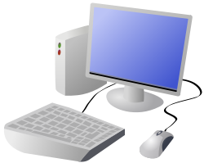
Poor Science Data Management Example
A wildlife biologist for a small field office was the in-house GIS expert and provided support for all the staff’s GIS needs. However, the data was stored on her own workstation. When the biologist relocated to another office, no one understood how the data was stored or managed.
Solution: A state office GIS specialist retrieved the workstation and sifted through files trying to salvage relevant data.
Cost: 1 work month ($4,000) plus the value of
data that was not recovered
Consider that the situation could have been worse, because the data was not being backed up as it would have been if stored on a server.
CC image by DTRave on
Open Clip Art Library
Notes:
A wildlife biologist for a small field office was the in-house GIS expert and provided support for all the staff’s GIS needs. However, the data was stored on her own workstation. When the biologist relocated to another office, no one understood how the data was stored or managed.
The solution: A state office GIS specialist retrieved the workstation and sifted through files trying to salvage relevant data.
The cost: 1 work month ($4,000) plus the value of data that was not recovered.
Consider that this situation could have been much worse because the data was not being backed up as it would have been if stored on a server.

Slide 22
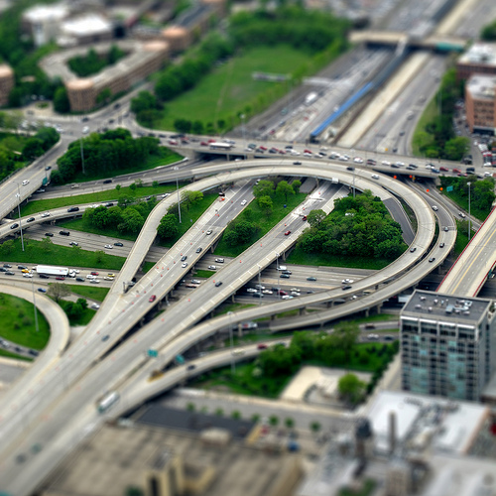
Poor Data Management Federal Agency Example
In preparation for a Resource Management Plan, an office discovered 14 duplicate GPS inventories of roads. However, because none of the inventories had enough metadata, it was impossible to know which inventory was best or if any of the inventories actually met their requirements.
Solution: Re-Inventory roads
Cost: Estimated 9 work months/inventory
@$4,000/wm
(14 inventories = $504,000)
CC image by ruffin_ready on Flickr
Notes:
In preparation for a Resource Management Plan, an office discovered 14 duplicate GPS inventories of roads. However, because none of the inventories had enough metadata, it was impossible to know which inventory was best or if any of the inventories actually met their requirements.
Solution: Re-Inventory roads
Cost: Estimated 9 work months/inventory
@$4,000/wm
(14 inventories = $504,000)

Slide 23
Importance of Data Management
“Please forgive my paranoia about protocols, standards, and data review. I'm in the latter stages of a long career with USGS (30 years, and counting), and have experienced much. Experience is the knowledge you get just after you needed it.
Several times, I've seen colleagues called to court in order to testify about conditions they have observed.
Without a strong tradition of constant review and approval of basic data, they would've been in deep trouble under cross-examination. Instead, they were able to produce field notes, data approval records, and the like, to back up their testimony.
It's one thing to be questioned by a college student who is working on a project for school. It's another entirely to be grilled by an attorney under oath with the media present.”
- Nelson Williams, Scientist US Geological Survey

Slide 24
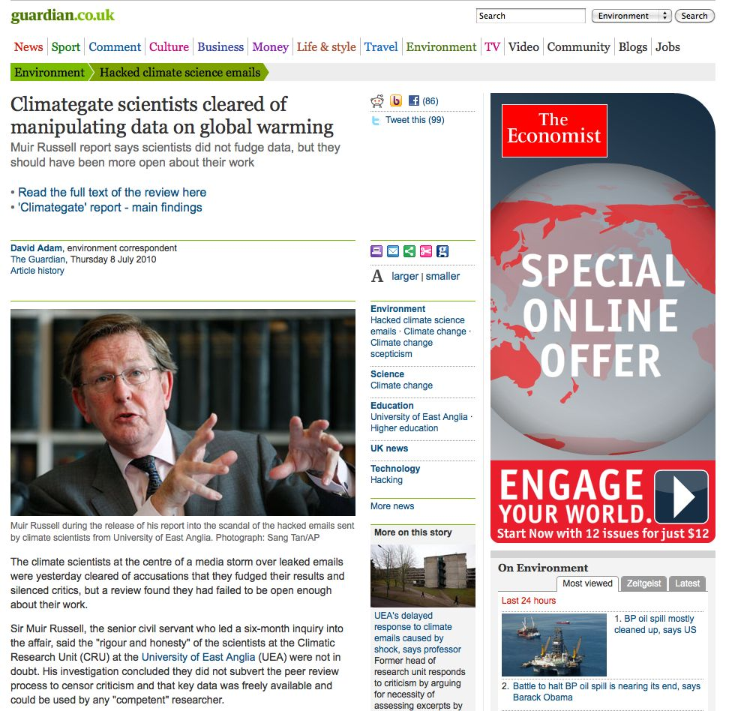
Importance of Data Management
The climate scientists at the centre of a media storm over leaked emails were yesterday cleared of accusations that they fudged their results and silenced critics, but a review found they had failed to be open enough about their work.

Slide 25
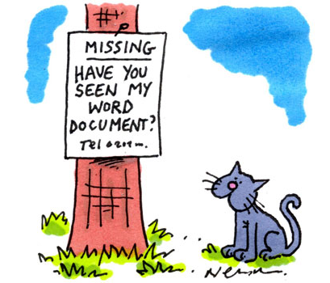
Why Manage Data?
From this . . .
http://www.thesundaytimes.co.uk/sto/multimedia/archive/00051/Panic-cartoon-580x35_51233a.jpg

Slide 26
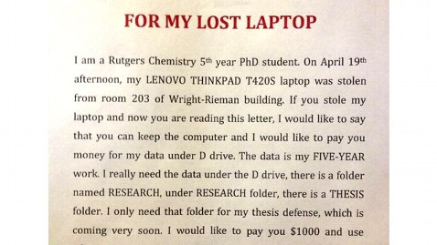
. . . to this . . .
http://abcnews.go.com/blogs/business/2013/04/rutgers-student-offers-1000-for-data-on-stolen-laptop/ - last visited 12/14/15

Slide 27
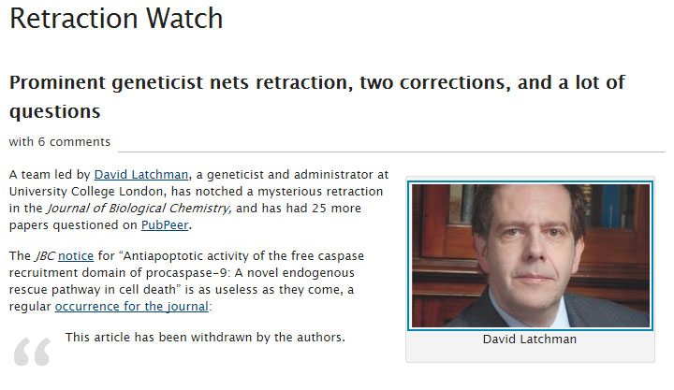
. . . to this . . .
http://retractionwatch.com/2015/01/20/prominent-geneticist-nets-retraction-two-corrections-lot-questions/#more-25256 – last visited 12/14/15

Slide 28
Readings for next class
Holdren, J (2013). Increasing Access to the Results of Federally Funded Scientific Research. Office of Science and Technology Policy, Executive Office of the President https://www.whitehouse.gov/sites/default/files/microsites/ostp/ostp_public_access_memo_2013.pdf
National Science Foundation. Dissemination and Sharing of Research Results. http://www.nsf.gov/bfa/dias/policy/dmp.jsp](http://www.nsf.gov/bfa/dias/policy/dmp.jsp
(see both the sharing and data management sections).
highly recommended
Karasti, H., Baker, K. S., & Halkola, E. (2006). Enriching the Notion of Data Curation in E-Science: Data Managing and Information Infrastructuring in the Long Term Ecological Research (LTER) Network. Computer Supported Cooperative Work (CSCW), 15(4), 321-358. https://dx.doi.org/10.1007/s10606-006-9023-2.
Posner, (2013). "Embarrassments of riches: managing research assets." http://miriamposner.com/blog/?p=982.
Gantz, J., & Reinsel, D. (2012). The Digital Universe in 2020: Big Data, Bigger Digital Shadows, and Biggest Growth in the Far East. Retrieved from https://www.emc.com/collateral/analyst-reports/idc-the-digital-universe-in-2020.pdf.

Slide 29
Why Manage Data: Researcher Perspective
Manage your data for yourself:
Keep yourself organized – be able to find your files (data inputs, analytic scripts, outputs at various stages of the analytic process, etc)
Track your science processes for reproducibility – be able to match up your outputs with exact inputs and transformations that produced them
Better control versions of data – identify easily versions that can be periodically purged
Quality control your data more efficiently
Notes:
Manage your data for yourself:
Keep yourself organized – be able to find your files (data inputs, analytic scripts, outputs at various stages of the analytic process, etc)
Track your science processes for reproducibility – be able to match up your outputs with exact inputs and transformations that produced them
Better control versions of data – identify easily versions that can be periodically purged
Quality control your data more efficiently

Slide 30
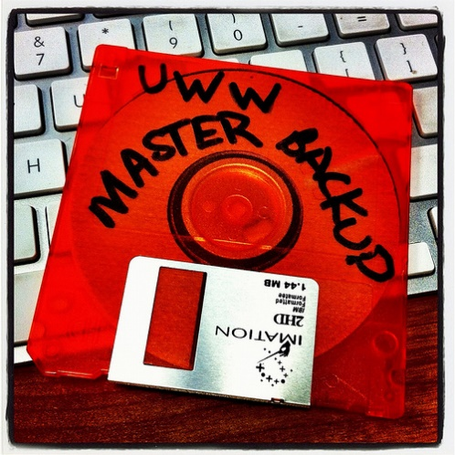
Why Data Management: Researcher Perspective
Make backups to avoid data loss
Format your data for re-use (by yourself or others)
Be prepared: Document your data for your own recollection, accountability, and re-use (by yourself or others)
Prepare it to share it – gain credibility
and recognition for your science efforts!
CC image by UWW ResNet on Flickr
Notes:
Manage your data for yourself:
Make backups to avoid data loss
Format your data for re-use (by yourself or others)
Be prepared: Document your data for your own recollection and re-use (by yourself or others)
Prepare it to share it – gain credibility and recognition for your science efforts

Slide 31
Why Data Management: Foundation to Advance Science
Data is a valuable asset – it is expensive and time consuming to collect
Data should be managed to:
maximize the effective use and value of data and information assets
continually improve the quality including: data accuracy, integrity, integration, timeliness of data capture and presentation, relevance and usefulness
ensure appropriate use of data and information
facilitate data sharing
ensure sustainability and accessibility in long term for re-use in science
Notes:
Data is a valuable asset – it is expensive and time consuming to collect
Data should be managed to:
maximize the effective use and value of data and information assets
continually improve the quality including: data accuracy, integrity, integration, timeliness of data capture and presentation, relevance and usefulness
ensure appropriate use of data and information
facilitate data sharing
ensure sustainability and accessibility in long term for re-use in science

Slide 32
Well managed, publically accessible data is important: why?
Here are a few reasons (from the UK Data Archive):
Increases the impact and visibility of research
Promotes innovation and potential new data uses
Leads to new collaborations between data users and creators
Maximizes transparency and accountability
Enables scrutiny of research findings
Encourages improvement and validation of research methods
Reduces cost of duplicating data collection
Provides important resources for education and training
Notes:
Well-managed, publically accessible data is important for a variety of reasons.
Here are a few (from the UK Data Archive):
Increases the impact and visibility of research
Promotes innovation and potential new data uses
Leads to new collaborations between data users and creators
Maximizes transparency and accountability
Enables scrutiny of research findings
Encourages improvement and validation of research methods
Reduces cost of duplicating data collection
Provides important resources for education and training

Slide 33
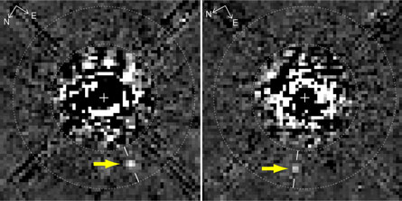
“Planet hidden in Hubble archives” Science News (Feb. 27, 2009)
New Discoveries
A new image processing technique reveals something not before seen in this Hubble Space Telescope image taken 11 years ago: A faint planet (arrows), the outermost of three discovered with ground-based telescopes last year around the young star HR 8799.D. Lafrenière et al., Astrophysical Journal Letters
D. Lafrenière et al., ApJ Letters
“The first thing it tells you is how valuable maintaining long-term archives can be. Here is a major discovery that’s been lurking in the data for about 10 years!” comments Matt Mountain, director of the Space Telescope Science Institute in Baltimore, which operates Hubble.
“The second thing its tells you is having a well calibrated archive is necessary but not sufficient to make breakthroughs — it also takes a very innovative group of people to develop very smart extraction routines that can get rid of all the artifacts to reveal the planet hidden under all that telescope and detector structure.”

Slide 34
Where a majority of data end up now…
Notes:
There is an abundance of data and metadata (if it is done) end up in filing cabinets, on discarded hard drives, in hard-copy journals on the library shelves -- or on the web, but many are subscription only journals.

Slide 35
Imagine if data were more accessible….
Notes:
Data should be properly managed and eventually be placed where they are accessible, understandable, and re-usable.

Slide 36
Quick Review
Lots of data, what to do with it?
Many researcher benefits of data management
Greater exposure of research
Easier workflows, less frustration, more productivity
Many scientific/social benefits of data management
Sharing and re-use
New discoveries
Not managing data is NOT an option
Cost are to high (both personal and professional)

Slide 37
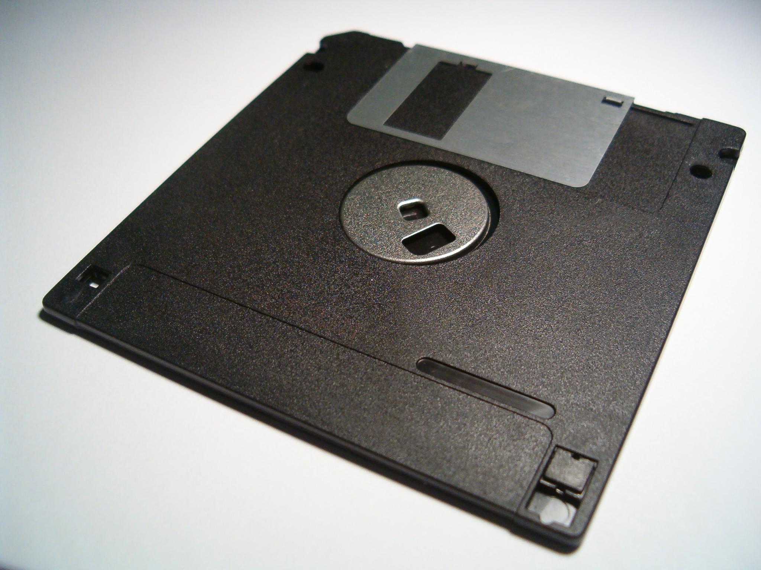
What is data management?
Actions that contribute to effective storage, preservation and reuse of
data and documentation throughout the research lifecycle.
Whitmire, Amanda L. (2014). Research Data Management Curriculum, Lecture 1: Introduction to Research Data Management. Oregon State University Libraries. Retrieved 11/04/2015 from: http://figshare.com/articles/GRAD521_Research_Data_Management_Lectures/1003835
Notes:
Data management is a verb – it involves intentional effort and activity.
The main goals of DM are preservation and reuse, for you and for others.
Covers all aspects of the data lifecycle from planning digital data capture methods, whittling down, ingestion to databases, providing for access and reuse, to transformation.

Slide 38
Data management is not:
Data science
Computational science
Database administration
A research method:
what data to collect
how to collect them
how to design an experiment
Whitmire, Amanda L. (2014). Research Data Management Curriculum, Lecture 1: Introduction to Research Data Management. Oregon State University Libraries. Retrieved 11/04/2015 from: http://figshare.com/articles/GRAD521_Research_Data_Management_Lectures/1003835
Notes:
If this is why you are here, you signed up for the wrong class.

Slide 39
What is DATA Management?
¿Data?
¿Management?
¿ TOOLS ?
File System Organization
File Naming Conventions
Privacy/Security Considerations
File Format Choice
Documentation and metadata
Roles and responsibilities in research environment
Storage and backup strategies
Acquiring and cleaning data
Sharing and collaboration strategies
Ownership of data
Access strategies / Access restrictions
Data publication / Data citation
Numbers
Words
Citations / references
Notebooks / marginalia
Specimens
Field Samples
Images
Videos / sound recording
Relationships
Models
Code
¿ VISUALIZATION?
Notes:
The Matrix - 1999
Big Data . . .
Talk to the data deluge, what are the responses in academia? In the public sector? Perhaps this is why we are here today?
NIH early data sharing requirements from grants over $500,000 – stringent controls for privacy and proprietary data
The 2011 NSF requirement to have data management plans in the grant proposals – there are program specific requirements
Most are simply two page documents with requirements to outline:
Data types to be collected
Standards to be used for metadata and data
Sharing policies (access, privacy, IP, etc.)
Re-use policies (distribution, derivatives
Plans for archival
Note that these requirements caused quite the scramble. No grant money if you could not include a plan.
Note that many foundations now also have data management requirements
Even private sector contracts require data management planning

Slide 40
and Research DATA Management?
Before: Data Management Planning / Grant Process
During: Compliance and Productivity
After: Publication and/or Repository Deposit
Notes:
The Matrix - 1999
Big Data . . .
Talk to the data deluge, what are the responses in academia? In the public sector? Perhaps this is why we are here today?
NIH early data sharing requirements from grants over $500,000 – stringent controls for privacy and proprietary data
The 2011 NSF requirement to have data management plans in the grant proposals – there are program specific requirements
Most are simply two page documents with requirements to outline:
Data types to be collected
Standards to be used for metadata and data
Sharing policies (access, privacy, IP, etc.)
Re-use policies (distribution, derivatives
Plans for archival
Note that these requirements caused quite the scramble. No grant money if you could not include a plan.
Note that many foundations now also have data management requirements
Even private sector contracts require data management planning

Slide 41
and Research DATA Management?
Before: Data Management Planning / Grant Process
Privacy/Security Considerations
Storage and backup strategies
File System Organization
File Naming Conventions
File Format Choice
Documentation and metadata
Roles and responsibilities in research environment
Sharing and collaboration strategies
Ownership of data
Access strategies / Access restrictions
During: Compliance and Productivity
After: Publication and/or Repository Deposit
Notes:
The Matrix - 1999
Big Data . . .
Talk to the data deluge, what are the responses in academia? In the public sector? Perhaps this is why we are here today?
NIH early data sharing requirements from grants over $500,000 – stringent controls for privacy and proprietary data
The 2011 NSF requirement to have data management plans in the grant proposals – there are program specific requirements
Most are simply two page documents with requirements to outline:
Data types to be collected
Standards to be used for metadata and data
Sharing policies (access, privacy, IP, etc.)
Re-use policies (distribution, derivatives
Plans for archival
Note that these requirements caused quite the scramble. No grant money if you could not include a plan.
Note that many foundations now also have data management requirements
Even private sector contracts require data management planning

Slide 42
and Research DATA Management?
Before: Data Management Planning / Grant Process
During: Compliance and Productivity
Follow file naming, organization and format conventions
Documentation and metadata
Acquiring and cleaning data
Regularly backup all data
Be mindful when sharing / version control
Access / privacy policy enforcement
After: Publication and/or Repository Deposit
Notes:
The Matrix - 1999
Big Data . . .
Talk to the data deluge, what are the responses in academia? In the public sector? Perhaps this is why we are here today?
NIH early data sharing requirements from grants over $500,000 – stringent controls for privacy and proprietary data
The 2011 NSF requirement to have data management plans in the grant proposals – there are program specific requirements
Most are simply two page documents with requirements to outline:
Data types to be collected
Standards to be used for metadata and data
Sharing policies (access, privacy, IP, etc.)
Re-use policies (distribution, derivatives
Plans for archival
Note that these requirements caused quite the scramble. No grant money if you could not include a plan.
Note that many foundations now also have data management requirements
Even private sector contracts require data management planning

Slide 43
and Research DATA Management?
Before: Data Management Planning / Grant Process
During: Compliance and Productivity
After: Publication and/or Repository Deposit
Publish
Deposit in a repository
Notes:
The Matrix - 1999
Big Data . . .
Talk to the data deluge, what are the responses in academia? In the public sector? Perhaps this is why we are here today?
NIH early data sharing requirements from grants over $500,000 – stringent controls for privacy and proprietary data
The 2011 NSF requirement to have data management plans in the grant proposals – there are program specific requirements
Most are simply two page documents with requirements to outline:
Data types to be collected
Standards to be used for metadata and data
Sharing policies (access, privacy, IP, etc.)
Re-use policies (distribution, derivatives
Plans for archival
Note that these requirements caused quite the scramble. No grant money if you could not include a plan.
Note that many foundations now also have data management requirements
Even private sector contracts require data management planning

Slide 44
Readings for second week Monday January 18th is a holiday!! (MLK Day)
Open Data Policy—Managing Information as an Asset. https://www.whitehouse.gov/sites/default/files/omb/memoranda/2013/m-13-13.pdf
Committee on Ensuring the Utility and Integrity of Research Data in a Digital Age (2009). “Promoting the Stewardship of Research Data” (Chap 4) in Ensuring the Integrity, Accessibility, and Stewardship of Research Data in the Digital Age. National Academies Press, Washington D.C. http://www.nap.edu/catalog/12615/ensuring-the-integrity-accessibility-and-stewardship-of-research-data-in-the-digital-age
Choose a DMP to read from https://dmptool.org/public_dmps. NOTE: “They are not vetted for quality, completeness, or adherence to funder guidelines.”
If your research lab has an existing DMP bring it to class
Read everything before Wednesday January 20th!!!

